Slide 1
Introduction to LLVM
Bojian Zheng
CSCD70 Spring 2018
bojian@cs.toronto.edu

Slide 2
What you will need for Assignment 1 …
LLVM: How to write a pass that analyzes and transforms (optimizes) Intermediate Representation (IR).
C++ Fundamentals: Public Inheritance (Abstract Class, Dynamic Casting), Iterator, STL Data Structures
Prerequisite

Slide 3
Three-Phase Design – From Source to Binary
Source Code
LLVM IR
LLVM IR
Front End
Passes
Back End
Object Code

Slide 4
Three-Phase Design – From Source to Binary
C/C++ Source
LLVM IR
int main()
{
return 0;
}
define i32 @main() … {
ret i32 0
}
clang

Slide 5
Example – IR Optimization
Suppose that we are hoping to replace every $x×2^{N}$ statement in our code with $x≪N$. How can we achieve this?
Write a Pass that does the followings:
Analyzes whether there are statements of the form $\%p=\operatorname{mul}{\%q, 2^{N}}$ in our code or not, and where are those statements located.
Transforms those instructions with $\%p=\operatorname{shl}{\%q, N}$.

Slide 6
IR Optimization
The IR optimizations consist of many optimization passes.
LLVM itself also has passes for analysis or transformations: https://llvm.org/docs/Passes.html
In this assignment, we will be making use of the mem2reg pass.
Please DON’T use the LLVM passes unless otherwise told to.

Slide 7
Questions?
Keywords:
Intermediate Representation (IR)
Optimization Pass
Analysis & Transformation

Slide 8
Analysis

Slide 9
How to write an analysis pass?
We need to understand the following three things:
Program Structure: How is our program represented in LLVM?
Iterators: How to traverse through such structures?
Downcasting: How to retrieve more information from iterators?
LLVM Pass Interface: Implement LLVM interface.

Slide 10
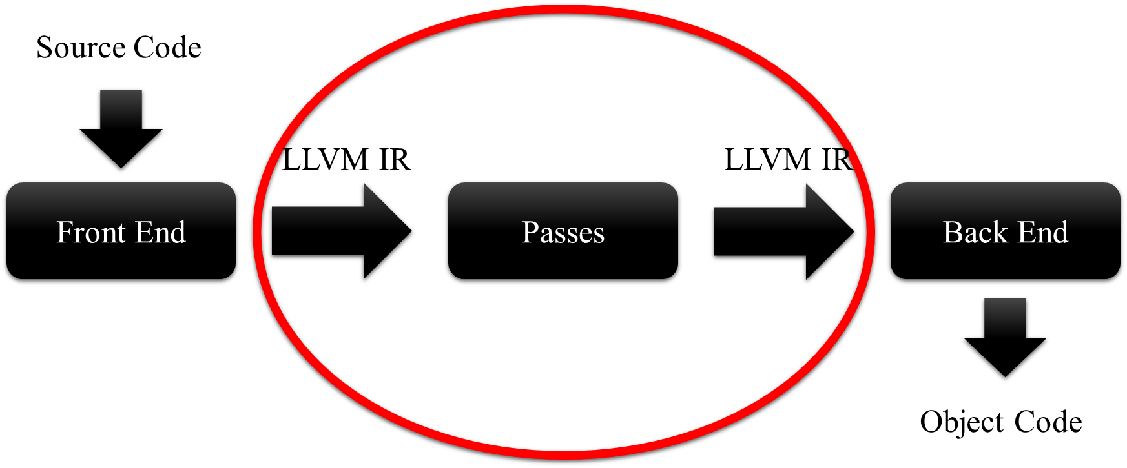
Program Structure
It is important that we understand how our programs are represented after being translated by the LLVM frontend clang:

Slide 11
Program Structure
C/C++ Source
LLVM IR
Source File
Function
Code Block
Statement
Module contains Functions and Global Variables.
Function contains Basic Blocks and Arguments.
Basic Block contains a list of Instructions.
Instruction is an Opcode plus vector of Operands.

Slide 12
Program Structure
A Simplified View (for Understanding ONLY):
typedef std::vector < Function > Module;
typedef std::vector < BasicBlock > Function;
typedef std::vector < Instruction > BasicBlock;
typedef std::vector < Operand > Instruction;

Slide 13
How to iterate through the Structures?
Iterators!
Recall how you traverse through std::vector
std::vector < unsigned > vec;
for (auto iter = vec.begin();
iter != vec.end(); ++iter)
{/* do something */}

Slide 14
How to iterate through the Structures?
Similarly, …
Module M;
for (auto iter = M.begin();
iter != M.end(); ++iter)
{/* do something */}

Slide 15
Downcasting – Getting More Details
Suppose that we have an instruction, how can we know whether it is an unary instruction? a binary instruction? a call instruction? …
Dynamic Casting!
Consider the statement UnaryInstruction * unary_inst = dyn_cast < UnaryInstruction > (inst);

Slide 16
LLVM Pass Interface
LLVM Interface
Implementation
class ModulePass
{
bool runOnModule (Module & M) = 0;
};
class MyModulePass : public ModulePass
{
bool runOnModule (Module & M)
{
for (iter = …
}
};

Slide 17
Questions?
Keywords:
Program Structure
Iterators
Downcasting
LLVM Pass Interface

Slide 18
Transformations

Slide 19
Insert/Remove/Move/Replace Instructions
Three Options
Instruction class methods:
insertBefore(), insertAfter(), moveBefore(), moveAfter(), eraseFromParent(), removeFromParent(), …
Ask parent (BasicBlock) to do this:
inst.getParent()->getInstList() .insert/erase/remove/…()
Make use of BasicBlockUtils (defined in header llvm/Transforms/Utils/BasicBlockUtils.h):
ReplaceInstWithValue(), ReplaceInstwithInst()

